Slide 1
Problem Statement
AI – POWERED INTERACTIVE LEARING ASSISTANT FOR CLASSROOMS

Slide 2
Unique Idea Brief (Solution)
The AI-Powered Interactive Learning Assistant is transforming classrooms by providing a dynamic and engaging learning environment for students. This innovative tool combines advanced listening and vision capabilities to understand students in real time, crafting personalized and emotionally attuned learning experiences.
Unlike traditional AI tools that simply answer questions, this assistant goes deeper by observing both emotional and cognitive responses from students. This ability allows it to adjust teaching methods on the fly, maximizing engagement and understanding. Through its unique "Engage-Detect-Adapt" loop, the assistant harnesses multimodal AI technology to foster relationships and interactions that are not only informative but also responsive to each student’s individual needs.
This results in a more effective, inclusive, and empathetic educational atmosphere, ensuring that every student feels supported and valued as they learn.

Slide 3
Features Offered
Admin Modules : Admin can upload study material in various formats like PDF, DOCX, or TXT, making it easy to prepare resources for students. Once uploaded, AI automatically extracts key topics and summaries.
Student Module : Students can view and read notes anytime through an interactive reader with options like search, highlight, and bookmark. Based on the content, AI creates topic-specific quizzes.
AI Assistant : Students can ask doubts related to the notes or quizzes using text or voice input, and receive AI-generated, easy-to-understand answers. Enables students to search any concept from the notes using natural language.
Learning Analytics : Monitors each student's activity like topics studied, quizzes attempted, and performance trends. Based on quiz performance, the system gives smart revision tips and identifies weaker areas.
Technical Features : A user-friendly and mobile-responsive interface that works across phones, tablets, and desktops.

Slide 4
Process flow
Admin Uploads Study Material : Admin logs in and uploads notes in any supported format (PDF, DOCX, TXT). AI reads and parses the content.
Student Accesses Notes : Student logs in and selects the subject/topic. The system displays the study material through an interactive viewer (highlight, search, bookmark).
AI Processes Notes : AI performs text extraction and summarization. Key topics are identified and stored in the database. Notes are organized by subject/topic for students to access.
AI Generates Quiz : Once a student finishes reading, the AI dynamically creates a quiz based on that specific topic. Quiz types: MCQs, True/False, Fill-in-the-blanks, Short Answers. Student takes the quiz.
Instant Feedback & Scoring : The AI evaluates the quiz instantly.
Doubt Clarification with AI Assistant : If the student has a doubt (from notes or quiz), they open the AI assistant. Input query using text or voice.

Slide 5
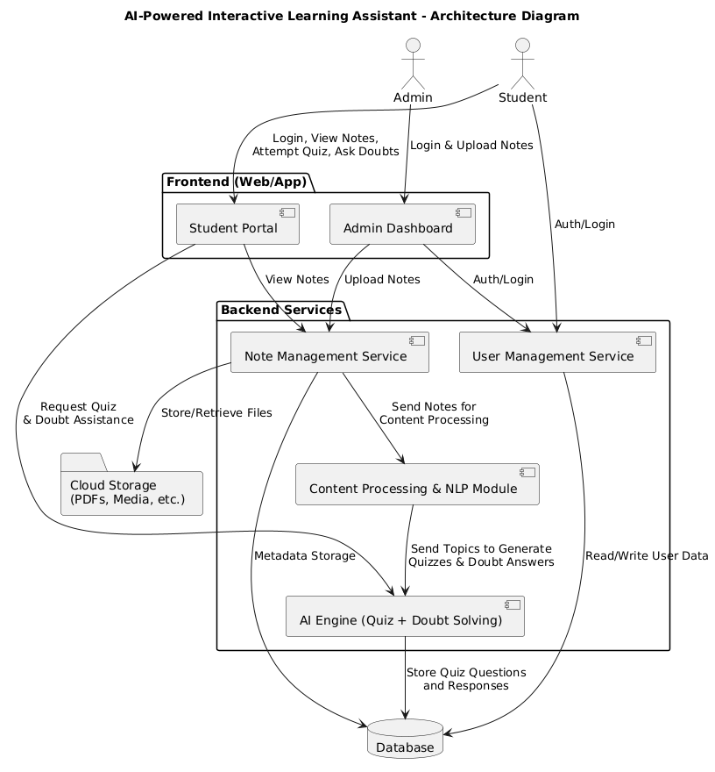
Architecture Diagram

Slide 6
Technologies used
Frontend :
React – JavaScript library for building dynamic user interfaces.
React DOM – Connects React with the browser's DOM.
React Dropzone – Enables drag-and-drop file uploads in the interface.
Lucide React – Icon library used for adding vector icons to the UI.
Backend :
Vite – Modern frontend build tool and development server
TypeScript – Strongly-typed version of JavaScript for better error checking and maintainability.
ESLint – Analyzes code for potential errors and enforces style rules.
TypeScript ESLint – Integrates ESLint with TypeScript.
ESLint Plugin React Hooks – Enforces best practices when using React hooks.
ESLint Plugin React Refresh – Enables fast refresh during development (hot reloading).

Slide 7
Team members and contribution:
Prasanna (Frontend Developer) :Designed and implemented the user interface using React and Tailwind CSS. Handled file upload (Drag & Drop) features and user interaction components
Akhil (Backend Developer) : Implemented backend logic using build tools and managed application structure. Integrated services like quiz generation and doubt resolution (AI module or APIs if applicable)
Sai Teja(Debugger & Documentation Lead) : Tested and debugged the application to ensure smooth functionality.Prepared and maintained project documentation, including user guide and report.

Slide 8
Conclusion
The AI-Powered Interactive Learning Assistant for Classrooms is a transformative solution designed to enhance the teaching and learning experience using artificial intelligence. By allowing administrators to upload study material in various formats, the system efficiently processes and organizes notes for student access. Through the integration of AI, the assistant generates quizzes automatically based on uploaded content, enabling self-assessment and deeper understanding.
Furthermore, the inclusion of an intelligent doubt-solving assistant that responds to student queries via text or voice ensures personalized and timely support, promoting continuous learning. This multimodal approach not only increases engagement but also bridges the gap between static content and dynamic interaction.
In summary, the project offers a smart, scalable, and accessible learning environment that empowers students with on-demand resources, interactive evaluation, and AI-driven assistance—setting the foundation for the future of education.

